Slide 1
Can AI Tell Your Cat From Your Dog and Even Its Breed?
Transfer Learning & FixMatch to Classify the Oxford-IIIT Pet Dataset
2025-05-23
DD2424 Project: Transfer Learning | Ksenia Biazruchanka, Tobias Haunreiter, Alexander Soukup, Johannes Jeup
1
Notes:
Ksenia 15 sec
Can AI tell your cat from your dog and even its breed? In this project my team and I set out to answer this question by trying out transfer learning and semi-supervised learning techniques to adapt a pre-trained ResNet50 model to classify images of various pet breeds.

Slide 2
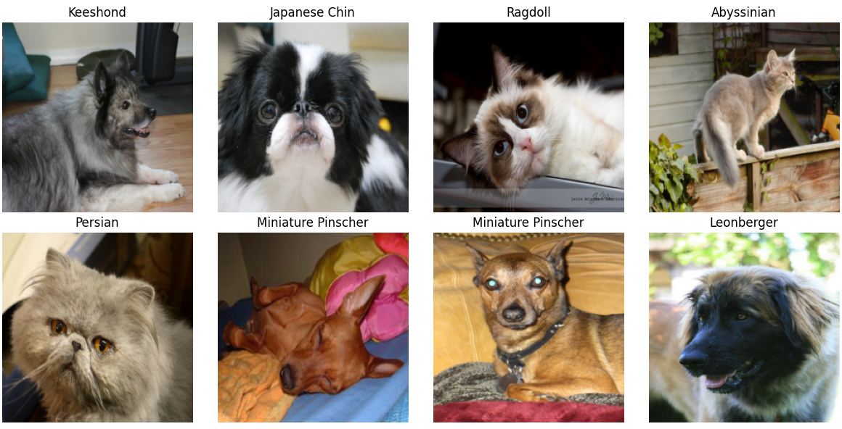
Oxford-IIIT Pet Dataset
2025-05-23
DD2424 Project: Transfer Learning | Ksenia Biazruchanka, Tobias Haunreiter, Alexander Soukup, Johannes Jeup
2
Notes:
15 sec. 37 breeds of cats and dogs, around 200 images per breed, 7300 images in total. fine-grained labels and
high intra-class variance
To do this we worked with Oxford-IIIT Pet Dataset. It includes 37 breeds of cats and dogs, with around 200 images per breed – 7300 images in total. The primarily motivation for using this dataset is to tackle the challenge of fine-grained classification, where differences between breeds are subtle and intra-class variability is high.

Slide 3
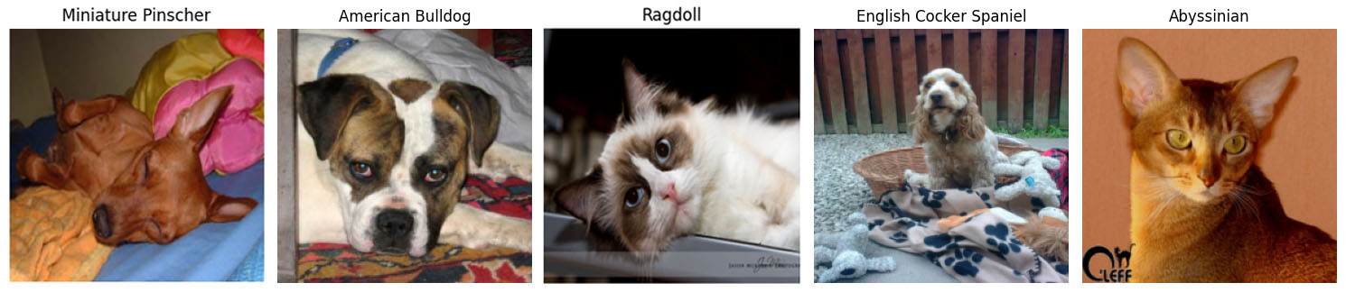
Oxford-IIIT Pet Dataset
37 Breeds of Cats and Dogs
200 Images per Breed
7349 Images in Total
Ksenia
2025-05-23
DD2424 Project: Transfer Learning | Ksenia Biazruchanka, Tobias Haunreiter, Alexander Soukup, Johannes Jeup
3
Notes:
15 sec. 37 breeds of cats and dogs, around 200 images per breed, 7300 images in total. fine-grained labels and
high intra-class variance
To do this we worked with Oxford-IIIT Pet Dataset. It includes 37 breeds of cats and dogs, with around 200 images per breed – 7300 images in total. The primarily motivation for using this dataset is to tackle the challenge of fine-grained classification, where differences between breeds are subtle and intra-class variability is high.

Slide 4
Binary Classification (Cat vs. Dog)
Strategy
Transfer Learning with ResNet50
Feature Extraction
Achieved 99.45% Validation Accuracy, 99.29% on the Test Set
2025-05-23
DD2424 Project: Transfer Learning | Ksenia Biazruchanka, Tobias Haunreiter, Alexander Soukup, Johannes Jeup
4
Notes:
Ksenia – 30s
We first tried to solve a binary classification problem, recognizing whether and image shows a cat or a dog. We used a pre-trained ResNet50 model and applied feature extraction, where we froze all the earlier layers and only trained the final classification layer. This approach let us achieve a test accuracy of above 99%.

Slide 5
Breed Classification
Strategies
Gradual Un-Freezing
Simultaneous Training of Last Layers
Further Improvements
Data Augmentation, L2 Regularization, Batch Norm Layers, Learning Rate Scheduling
Strategy | Network | Data Aug. | L2 | Learning Rate | Test Accuracy
Feature Extraction | ResNet18 | False | None | Constant | 85.69%
Un-Freezing | ResNet50 | True | λ = 1e-2 | Layer Decay | 92.37%
Simult. Training | ResNet50 | True | λ = 1e-3 | Epoch Decay | 92.64%
2025-05-23
DD2424 Project: Transfer Learning | Ksenia Biazruchanka, Tobias Haunreiter, Alexander Soukup, Johannes Jeup
5
Notes:
For the breed classification we aim to determine all 37 cat and dog breeds.
Therefore we evaluated and implemented two main strategies including training with unfreezing one layer at a time and simultaneously training the last layers as a second strategy.
Additionally further improvements were considered like data augmentation, L2 regularization, training or not the batch norm layers and learning rate scheduling.
The results of our experiments can be seen in the table and show a clear improvement in performance compared to the feature extraction that was used for the binary classification.
The best result was obtained for simultaneously tuning up to the second layer.
Feature Ex: 25 epochs, eta = 0.0001
Unfreezing: L=4 for 3 epochs, eta = 0.0001, decay of 20% per layer
Simult. Training: up to layer 2 for 5 epochs, eta = 0.0001, decay of 35% per epoch
Alex – 40s

Slide 6
Imbalanced Classes
Number of Images per Cat Breed: 20 %
Compensation Strategies:
Weighted Cross-Entropy Loss
Over-Sampling of the Cat Breed Classes
Both Proved to Be Equally Effective but Were Not Able to Fully Compensate
Scenario | Test Accuracy (%)
Benchmark w/o Imbalanced Classes | 92.64%
w/o Compensation | 86.15%
Weighted Cross-Entropy Loss | 89.64%
Over-Sampling | 89.70%
2025-05-23
DD2424 Project: Transfer Learning | Ksenia Biazruchanka, Tobias Haunreiter, Alexander Soukup, Johannes Jeup
6
Notes:
Johannes - 20s

Slide 7
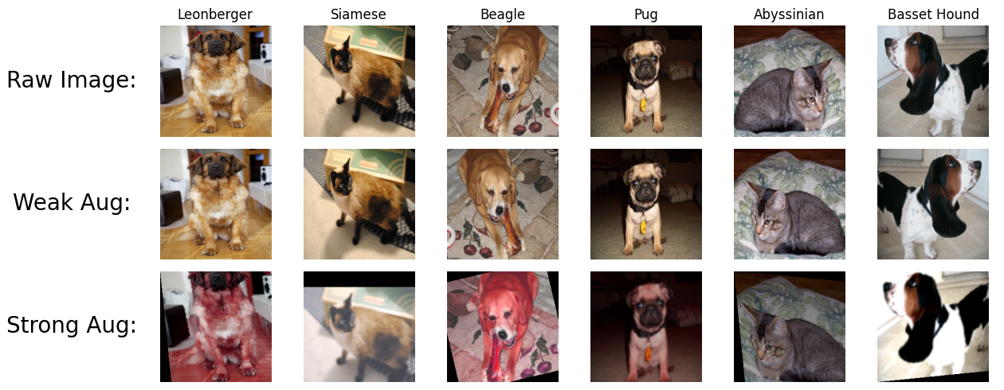
FixMatch (SSL)
Use Only a Few Labeled Samples per Class
Method: Semi-Supervised Learning with Weak/Strong Augmentations
Combine Consistency Regularization and Pseudo-Labeling
Use Supervised Loss for Labeled Data and Unsupervised Loss for the Unlabeled Samples
2025-05-23
DD2424 Project: Transfer Learning | Ksenia Biazruchanka, Tobias Haunreiter, Alexander Soukup, Johannes Jeup
7
Notes:
Tobi – 1:40 min (both slides)
Consistency Regularization: Leverage unlabeled data by assuming similar network outputs for augmented versions of the sample --> enhances robustness and generalization
Pseudo-Labeling: Use model's predictions as artificial labels for unlabeled data (but only with high confidence, i.e. above a certain threshold)
Weak Augmentation: Image normalization (clip to [0, 1]), random horizontal flipping, random resize crop (224 x 224 x 3)
Strong Augmentation: weak + random color jitter (80%), gaussian blur (50%), random rotation (±15 deg)

Slide 8
FixMatch (SSL)
Results and Ablation Study
With More Labeled Data FixMatch Does Not Improve Performance
For Less Labeled Samples FixMatch Outperforms Supervised Learning Strategy
Images per Class | Labeled Data | Supervised | FixMatch
50 | 60% | 89.48% | 90.35%
20 | 25% | 88.42% | 87.64%
10 | 12.5% | 70.24% | 86.41%
2 | 2.5% | 11.99% | 72.91%
1 | 1% | 5.56% | 50.15%
2025-05-23
DD2424 Project: Transfer Learning | Ksenia Biazruchanka, Tobias Haunreiter, Alexander Soukup, Johannes Jeup
8
Notes:
Tobi
Threshold Pseudo-Label: tau = 95%
Weight unsupervised loss: lam_u = 1
Training for 10 epochs (20 and 50 images per class: 5 epochs)

Slide 9
So, Can AI Tell Your Cat From Your Dog
And Even Its Breed?
2025-05-23
DD2424 Project: Transfer Learning | Ksenia Biazruchanka, Tobias Haunreiter, Alexander Soukup, Johannes Jeup
9
Notes:
Johannes – 20 sec

Slide 10
So, Can AI Tell Your Cat From Your Dog
And Even Its Breed?
Absolutely - And It Might Even Know Your Pet Better Than Your Local Vet (Just Don’t Tell the Vet That).
Scenario | Test Accuracy (%)
Binary classification | >99%
Breed classification | >92%
FixMatch (SSL) (2 labeled images per class) | >72%
2025-05-23
DD2424 Project: Transfer Learning | Ksenia Biazruchanka, Tobias Haunreiter, Alexander Soukup, Johannes Jeup
10
Notes:
Johannes – 20 sec

